Slide 1
Predicting Success of Movies and Video Games
By: Daniel Gomes, John Gomes and Blake Simmons

Slide 2
Motivation
Our goal: Analyze how different qualities predict the success of both movies (revenue) and video games (global sales).
What we mean by qualities:
Movies: Lead role, budget, production company, etc.
Video Games: Platform, developer, publisher, genre, etc.
Our motivation: Due to our own personal interests in the movie and video game industries.

Slide 3
Datasets
The datasets we will be using for the creation of our final project are:
Movies: TMDB 5000 Movie Dataset - Metadata on ~5,000 movies from TMDb
https://www.kaggle.com/tmdb/tmdb-movie-metadata
Video Games: Video Game Sales with Ratings - video game sales from Vgchartz and corresponding ratings from Metacritic
https://www.kaggle.com/rush4ratio/video-game-sales-with-ratings

Slide 4
Datasets (Further Look)
Movies Dataset:
budget Money spent creating movie
genres Type of movie (Horror, Comedy)
homepage Movies internet home address
id Identification of movie
keywords Iterated words throughout movie
original_language Language movie was created
original_title Name given to movie in production
overview Summary of movie
popularity General Public interest in movie
production_companies Companies involved in filming
production_countries Countries movie was filmed in
release_date MM/DD/YYYY movie came out
revenue How much the movie made ($US)
runtime How long the move is
spoken_languages Languages in the movie
status In theatres, dvd, digital copy, etc.
tagline Catchphrase/Slogan of movie
title Name of the movie
vote_average Average vote score
vote_count Number of votes for the movie
Video Game Dataset:
Name Name of the video game
Platform Console on which the game is running
Year_of_Release Year of the game released
Genre Game's category
Publisher Publisher
NA_Sales Game sales in North America (in millions of units)
EU_Sales Game sales in the European Union (in millions of units)
JP_Sales Game sales in Japan (in millions of units)
Other_Sales Game sales in the rest of the world, i.e. Africa, Asia excluding
Japan, Australia, Europe excluding the E.U. and South America (in millions of units)
Global_Sales Total sales in the world (in millions of units)
Critic_Score Aggregate score compiled by Metacritic staff
Critic_Count The number of critics used in coming up with the Critic_score
User_Score Score by Metacritic's subscribers
User_Count Number of users who gave the user_score
Developer Party responsible for creating the game
Rating The ESRB ratings (E.g. Everyone, Teen, Adults Only..etc)

Slide 5
Machine Learning Techniques and Evaluation Methods
Supervised Learning:
We are predicting an outcome based on independent variables.
Predict financial success, in the form of revenue.
Lasso Regression:
Simple and effective and easy to evaluate correlative variables.
Evaluation Methods: Cross validation to evaluate prediction accuracy and determine best lambda, RMSE to analyze the fit of the model.
Regression Tree (Random Forest):
Simplicity of results (easy to understand a tree model), ability for fine tuning.
Evaluation Methods: CV for tree size, RMSE to analyze the model.

Slide 6
Movies Dataset
Cleaning the Data
Had to eliminate several columns due to more than 53 factor levels (including starring, director, production_company, others)
Random Forest function can not process factors with more than 53 levels. In order to compare the two models, the attributes needed to be identical.
Lots of clean-up required - nearly a quarter of rows were missing data

Slide 7
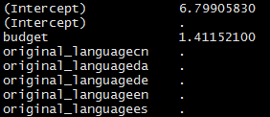
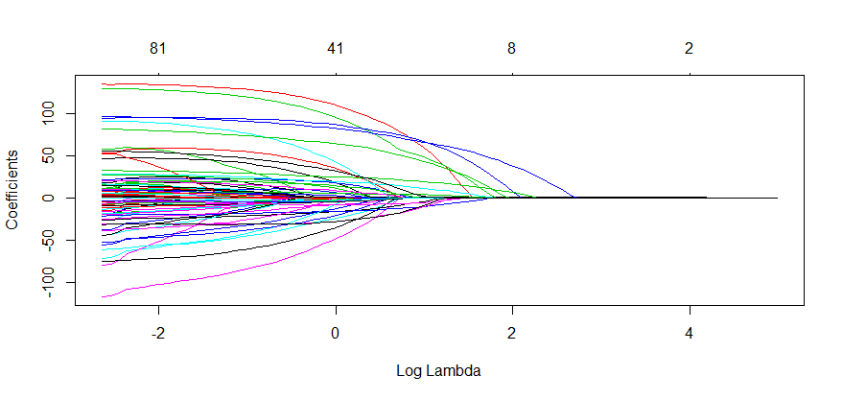
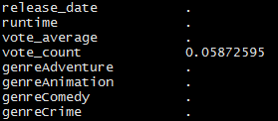
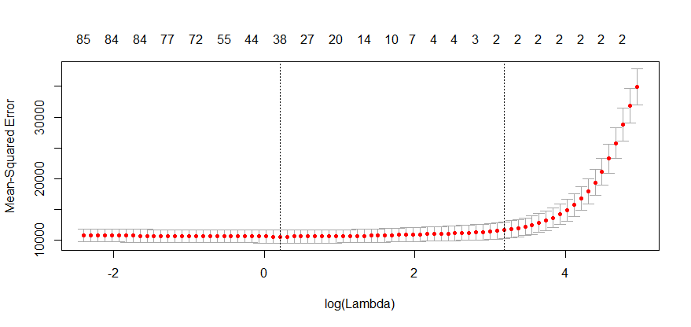
Results - Movies Dataset
Lasso Regression
Best Lambda: 24.13829
All variables eliminated except for
budget and vote_count.

Slide 8
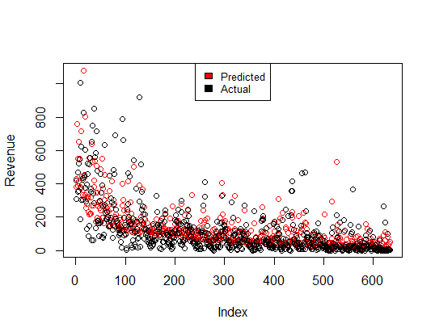
Results - Movies Dataset
Lasso Regression
RMSE: 96.5230200967387
R-squared: 0.6987305
Final Formula:
revenue = 6.79905830 + (budget * 1.411) + (vote_count * 0.058)

Slide 9
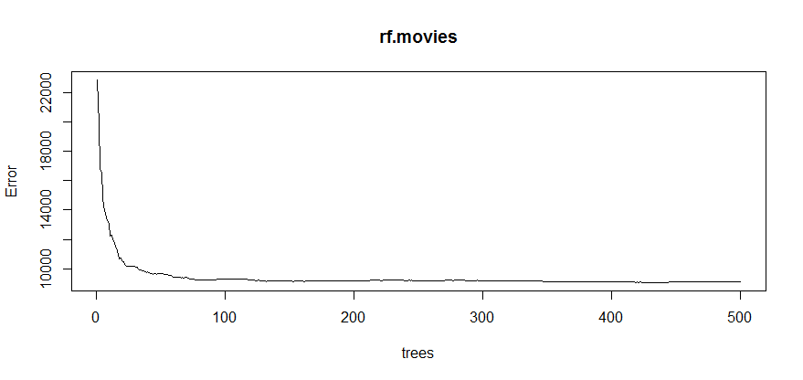
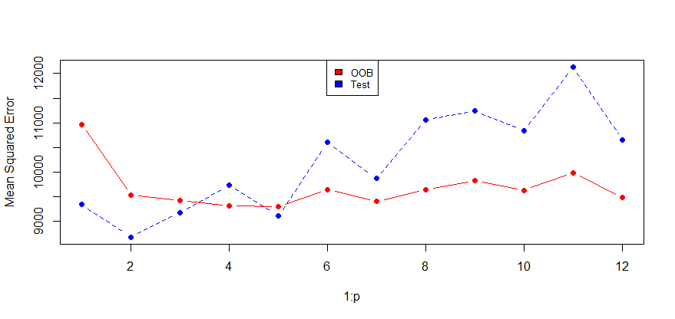
Results - Movies Dataset
Random Forest
125 trees Mtry = 2

Slide 10
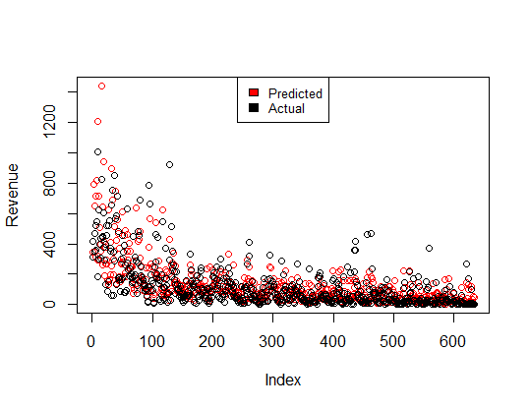
Results - Movies Dataset
Random Forest
RMSE: 94.6004570140387
R-squared: 0.6660517

Slide 11
Games Dataset
Cleaning the Data
Only used completed rows from our dataset
This cut our dataset pretty much in half (~14,000 → ~7000)
Had to reformat some of the columns so they could fit our methods (i.e. Factor to Numeric)
Had to remove some columns due to factors of too many levels

Slide 12
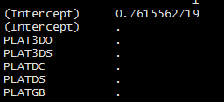
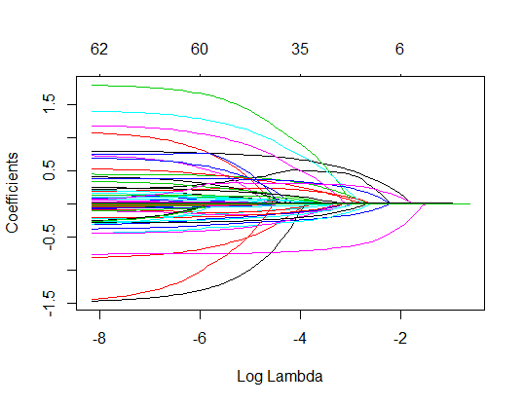

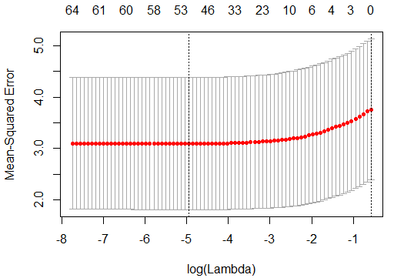
Results - Games Dataset
Lasso Regression
Best Lambda: 0.5612952
All variables eliminated except for
Critic Count
(given tiny coefficient)

Slide 13
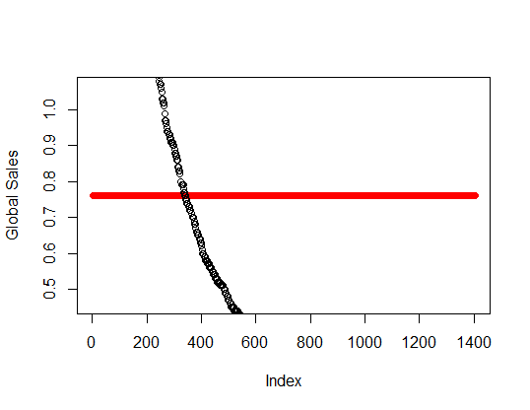
Results - Games Dataset
???
Lasso Regression
RMSE: 2.02496867599784
R-squared: 0.1774034
Final Formula:
Global sales = 0.7615562719 + (Critic Count * 0.0001908167)

Slide 14
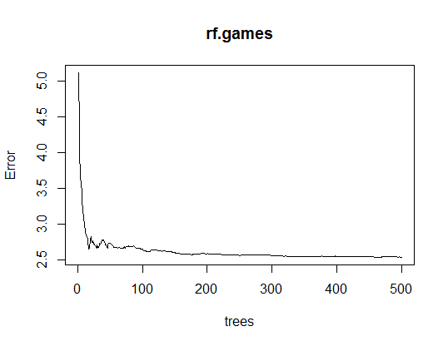
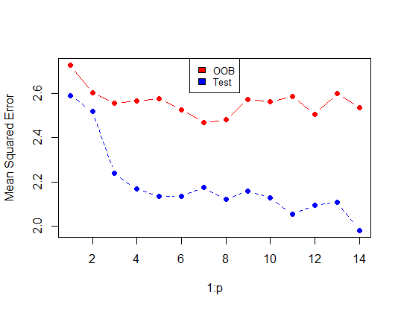
Results - Games Dataset
Random Forest
175 trees Mtry = 12

Slide 15
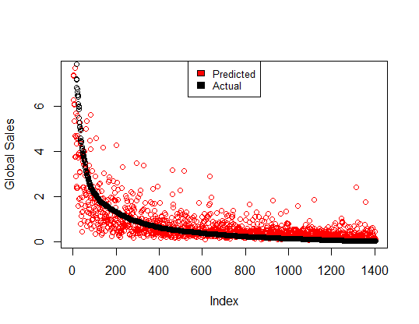
Results - Games Dataset
Random Forest
RMSE: 1.44290201087766
R-squared: 0.4921552

Slide 16
Conclusion
Both methods were decent at predicting movie revenue but used very few attributes from the dataset
Lasso regression was not good for predicting game sales based on attributes other than specified nation sales.
Random Forest was much better for predicting game sales.
These datasets were not ideal for our purposes, but could serve as a basis of experimentation for collecting data in the future - keep good predictors, try adding new data attributes to datasets.

Slide 17
References
(TMDb), The Movie Database. “TMDB 5000 Movie Dataset.” Kaggle, 28 Sept. 2017, www.kaggle.com/tmdb/tmdb-movie-metadata.
Kirubi, Rush. “Video Game Sales with Ratings.” Kaggle, 30 Dec. 2016, www.kaggle.com/rush4ratio/video-game-sales-with-ratings.
“RandomForest.” R Documentation, www.rdocumentation.org/packages/randomForest/versions/4.6-14/topics/randomForest.
“Ridge Regression and the Lasso.” R-Bloggers, 23 May 2017, www.r-bloggers.com/ridge-regression-and-the-lasso/.

Slide 18
All group members contributed equally.

